Slide 1
Module 3

Slide 2
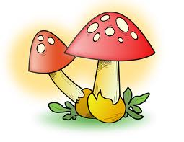
Breakdown food into simple substances
outside the body
Then absorb it inside
Some organisms
E.g. Fungi like yeast and mushroom & some carnivorous plants.
Let us see how ?
Plants which feed on insects
Mushroom
Releases enzymes
Digests food into simple substances
Food particles
Absorbs

Slide 3
Some organisms
Breakdown food
inside the body
Then Absorb it
E.g. Human beings, cat & cow
Let us see how ?

Slide 4
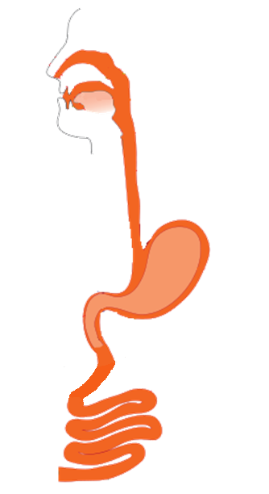

Food taken in
Broken down into simple substances
Absorbed in Blood

Slide 5
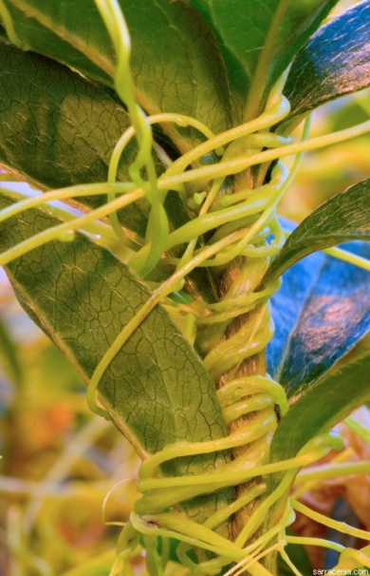
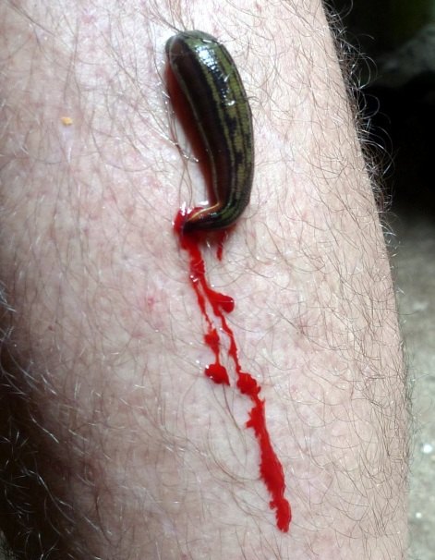
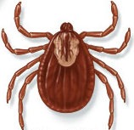
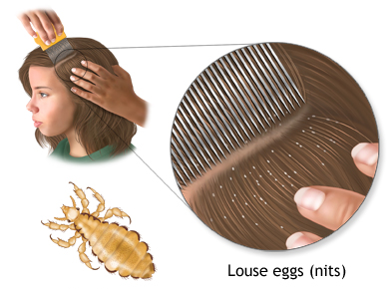
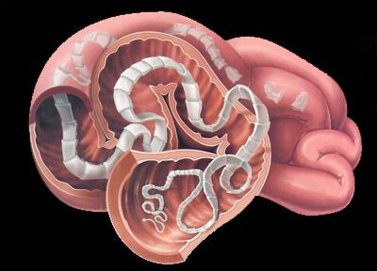
Some animals and plants derive nutrition from other plants or animals without killing them.
But during the process they harm the host plant or animals.
E.g. cuscuta, ticks, lice, leeches, tapeworms, etc.
Worms found in the intestine of man and derives nutrition from there.
Parasite found on the bodies of animals like dogs.
Parasitic plant which derives nutrition from other plants.
Parasite found in hair of animals.
Blood sucking parasite

Slide 6

How do organisms obtain their nutrition?

Slide 7
Since the food and the way it is obtained differ, the digestive system is different in various organisms.
In single – celled organisms, the food may be taken in by the entire surface.
But as the complexity of the organism increases, different parts become specialised to perform different functions.

Slide 8

For e.g. amoeba takes in food using temporary finger-like extensions of the cell surface which fuse over the food particle forming food-vacuole.
Inside the food vacuole, complex substances are broken down into simpler ones which then diffuse into the cytoplasm.
The remaining undigested material is moved to the surface of the cell and thrown out.
Pseudopodia
Food
Pseudopodia
Amoeba
Pseudopodia engulf food
Digestive products
Food-vacuole
Undigested material

Slide 9
Thank You

